Slide 1
CS 33 – Discussion 1A Computer System Organization
Week 2

Slide 2
Questions before we start?

Slide 3
Logistics
Homework #1 due tonight
Lab 1 due next week Friday 4/17
TA site made for uploading disc recordings
Also can upload anonymous feedback to improve disc

Slide 4
Agenda
10am-11am PST:
x86-64 basics
Linux/Vim basics
Compilation/assembly code example
11am-11:50am PST:
LA worksheet

Slide 5
x86-64 Basics – CISC/RISC
X86-64 is a CISC is a “Complex Instruction Set Computer”
Started because instructions were more compact – instruction memory took up less space, a concern back when we had small memory capacity
Many complex instructions possible
Vector operations (SIMD)
Single byte instructions (push/pop)
many, many more
RISC is “Reduced Instruction Set Computer”
Small set of fundamental instructions that get repeated
Example architecture is MIPS
(Microprocessor without Interlocked Pipelined Stages)
I – R – J type instructions
all instructions 32 bits

Slide 6
x86-64 Basics - ISA
RISC and CISC are examples of an ISA
Instruction System Architecture
Essentially the interface between the hardware and software
Defines the type of instructions we see in assembly
Also defines the view of the hardware the complier sees (e.g. number of registers that can be used for register renaming/coloring)
Microarchitecture is the actual physical implementation of the ISA (digital circuits [NAND gates], sounds like fun right? If you want to keep going lower you reach analog circuits [BJT/CMOSFET transistors], even lower would be material science/semiconductor physics concerned with manufacturing the transistor diagrams [e.g. Molecular Beam Epitaxy or Photolithogrpahy or EBL])

Slide 7
x86-64 Basics - Code
Machine code:
The actual 10101..1110 binary encodings of instructions that correspond to high/low voltages for the circuit that defines your processor
Assembly code:
Higher level than machine code but lower level than regular code
Strong correspondence between instructions in assembly and object code (e.g. these 5 bytes are movl $0x01,%rax)

Slide 8
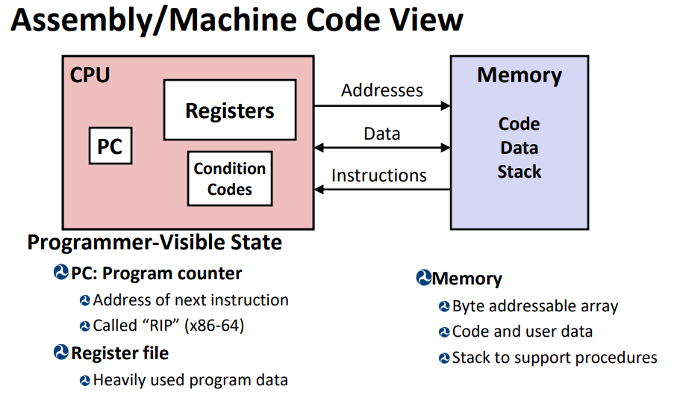
x86-64 Basics - CPU

Slide 9
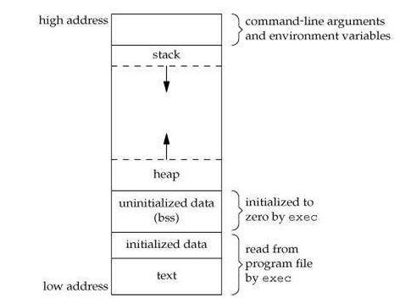
x86-64 Basics – Memory layout
We assume memory is one large contiguous byte addressable array (we will see later this is an abstraction we can use thanks to virtual memory)

Slide 10
x86-64 Basics – Memory layout
Stack contains the memory for the function call stack (grows downwards)
Heap contains the memory dynamically allocated (grows upwards
Memory in-between them is free until you over allocated (forgot to clean up memory that you “new”)
.bss is reserved space for uninitialized global/static vars
.data is reserved space for global/static variables
Text contains the instructions themselves

Slide 11
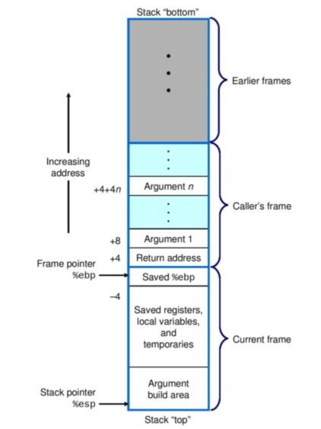
x86-64 Basics – Memory layout
Early look at a stack frame
Func stack frame contains:
Local vars
Return addr
Extra func args
Cant fit in reg file
Calle saved registers

Slide 12
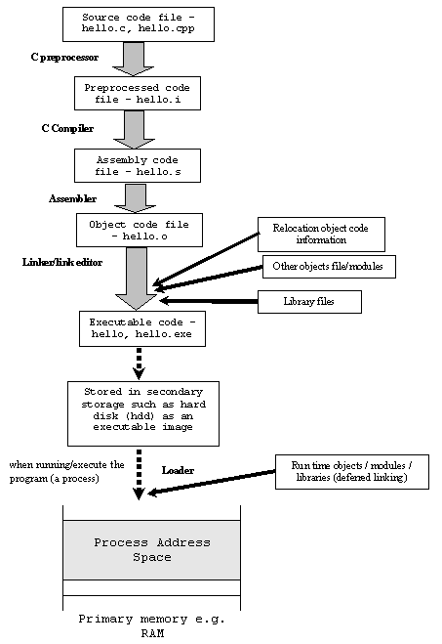
x86-64 Basics – text to object code

Slide 13
Linux Basic Commands
pwd – print working directory
cd – change directory
ls – lists contents of directory (-a lists all, -l prints more info)
mkdir dir_name – makes a directory with dir_name
rm file/dir – removes file or dir (use –r flag for dir)
touch file_name.file_type – creates file_name.file_type in current dir
vim file_name.file_type – opens file_name.file_type (e.g. bits.c) with the vim text editor
emacs is an alternative text editor ( or nano)
or you can develop locally and winscp files to seas

Slide 14
Linux Basic Commands
gcc flags output_file input_files* - compiles input_files into output_file using a compiler that follows c coding standards
gdb – launches GNU debugger
works for many languages like ada C/C++ fortran etc
can set breakpoints and step through code
print out stack traces
disassemble object code (reverse engineer object code)
objdump –d obj_file – disassembles object file outside of gdb

Slide 15
VIM Basic Commands
gg – go to last line of doc
G – go to first line of doc
#G – go to line number #
cntrl + f – move forward one screen
cntrl + b – move back one screen
i – switch to insert mode
v – switch to visual mode (lets you select things to yank (copy) text
y – yank (copy) marked text
d – delete marked text
> / < - shift left / right
p – paste
yy – copy line
dd – cut line
:w – write but don’t exit
:wq – write and exit
:q – quit, need to do :q! to force quit (drop any un-saved changes)
/pattern – search for pattern, ?pattern searches backwards for pattern
u - undo

Slide 16
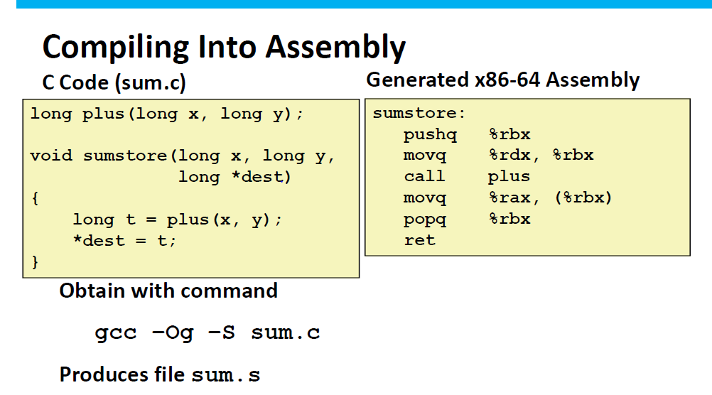
Compilation example

Slide 17
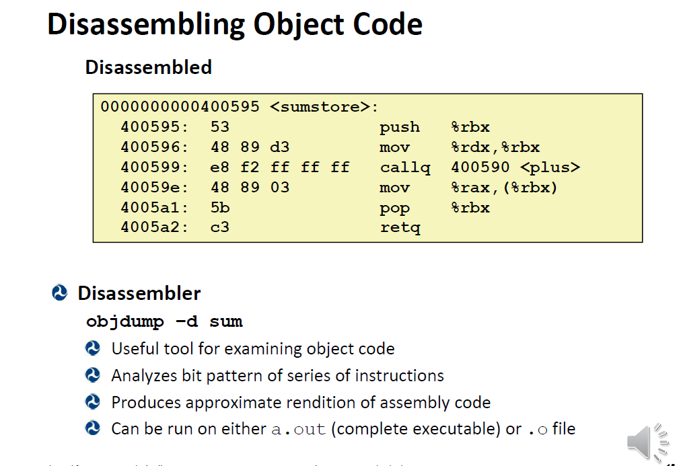
Objectdump example

Slide 18
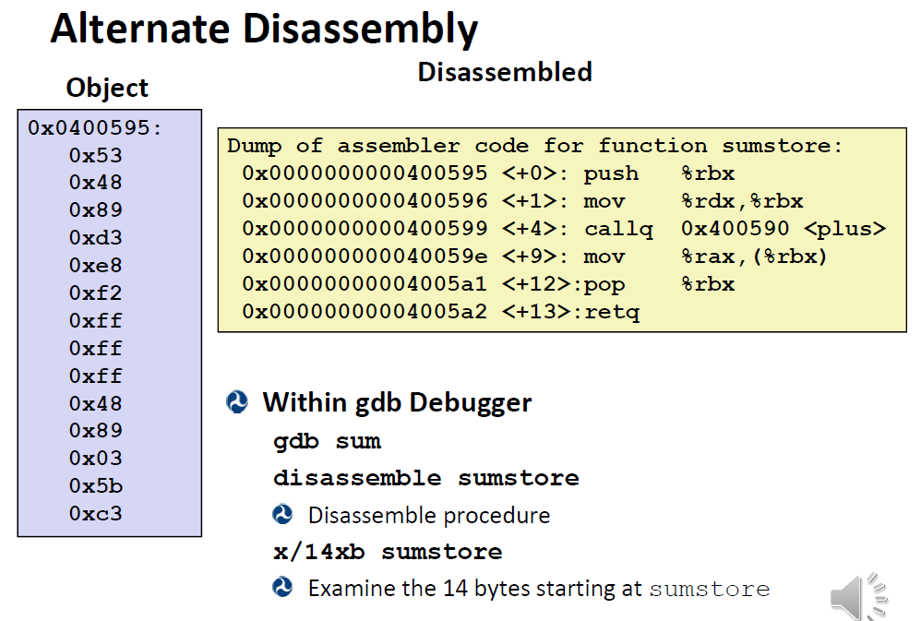
Gdb example
Notes:
Also show step = s, n = next, b <addr> is breakpoint there, l –lists code where the crash or bpoint, p var prints variable contents, I r – prints register contents

Slide 19
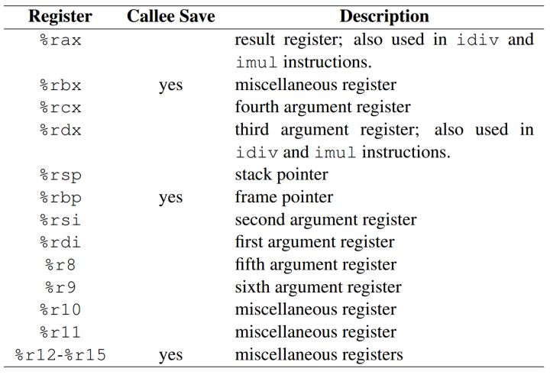
x86-64 registers
Notes:
Also show step = s, n = next, b <addr> is breakpoint there, l –lists code where the crash or bpoint, p var prints variable contents, I r – prints register contents

Slide 20
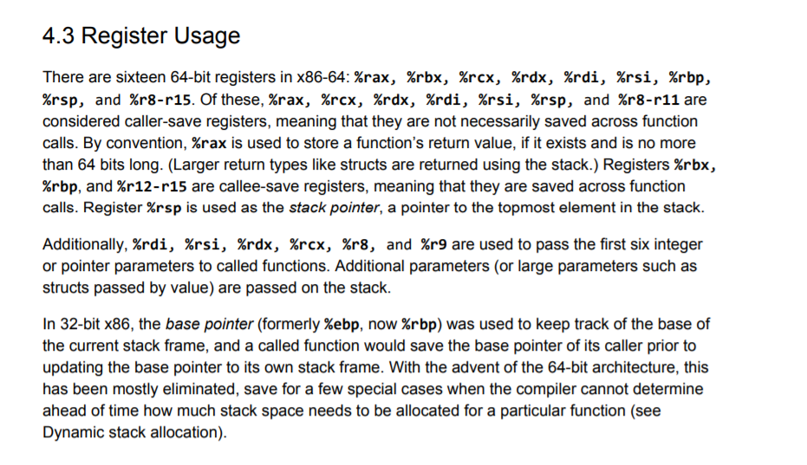
x86-64 registers
%rip – instruction pointer, contains address for next ins for processor
Notes:
Also show step = s, n = next, b <addr> is breakpoint there, l –lists code where the crash or bpoint, p var prints variable contents, I r – prints register contents

Slide 21
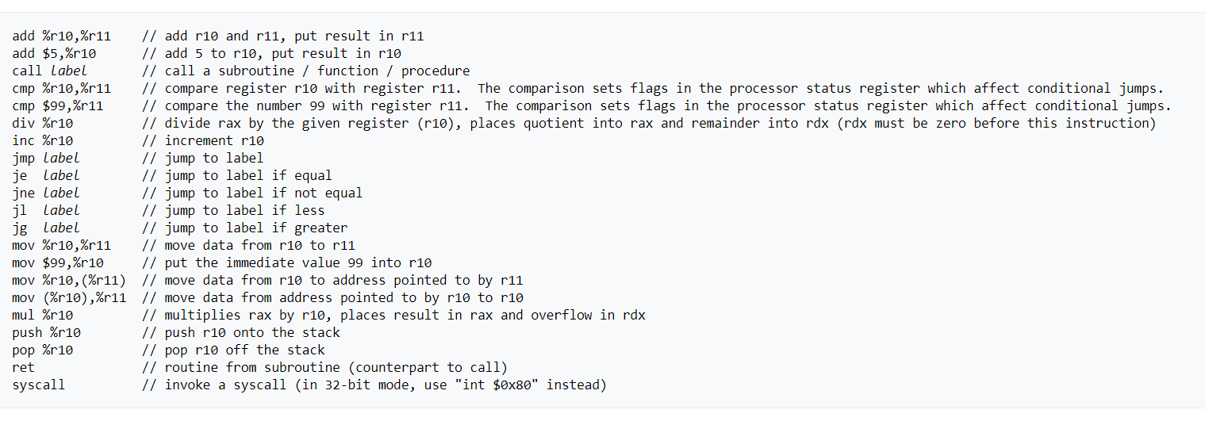
x86-64 basic commands
Notes:
Also show step = s, n = next, b <addr> is breakpoint there, l –lists code where the crash or bpoint, p var prints variable contents, I r – prints register contents

Slide 22
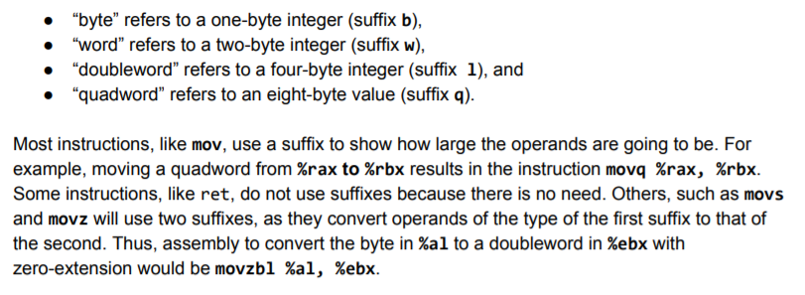
x86-64 command suffixes
Notes:
Also show step = s, n = next, b <addr> is breakpoint there, l –lists code where the crash or bpoint, p var prints variable contents, I r – prints register contents

Slide 23
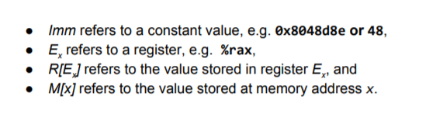
x86-64 operand types
Note you cannot use two memory operands in one operation
Notes:
Also show step = s, n = next, b <addr> is breakpoint there, l –lists code where the crash or bpoint, p var prints variable contents, I r – prints register contents

Slide 24
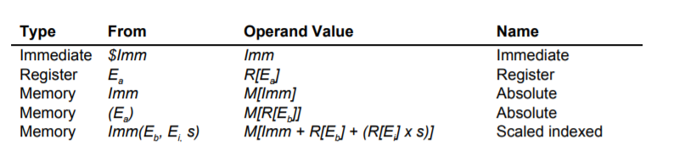
x86-64 addressing modes
Note you cannot use two memory accessing in one operation
Why?
Notes:
Also show step = s, n = next, b <addr> is breakpoint there, l –lists code where the crash or bpoint, p var prints variable contents, I r – prints register contents, layout reg can show you what registers change in each ins

Slide 25
Questions before we start worksheet?

Slide 26
Resources used
https://cs.brown.edu/courses/cs033/docs/guides/x64_cheatsheet.pdf
https://cs.stackexchange.com/questions/76871/how-are-variables-stored-in-and-retrieved-from-the-program-stack
https://www.geeksforgeeks.org/memory-layout-of-c-program/
https://vim.rtorr.com/
https://www.tenouk.com/ModuleW.html
Professor Reinman’s slides (CCLE)
Credit for slides: Attiano Purpura-Potoniere

